Slide 1
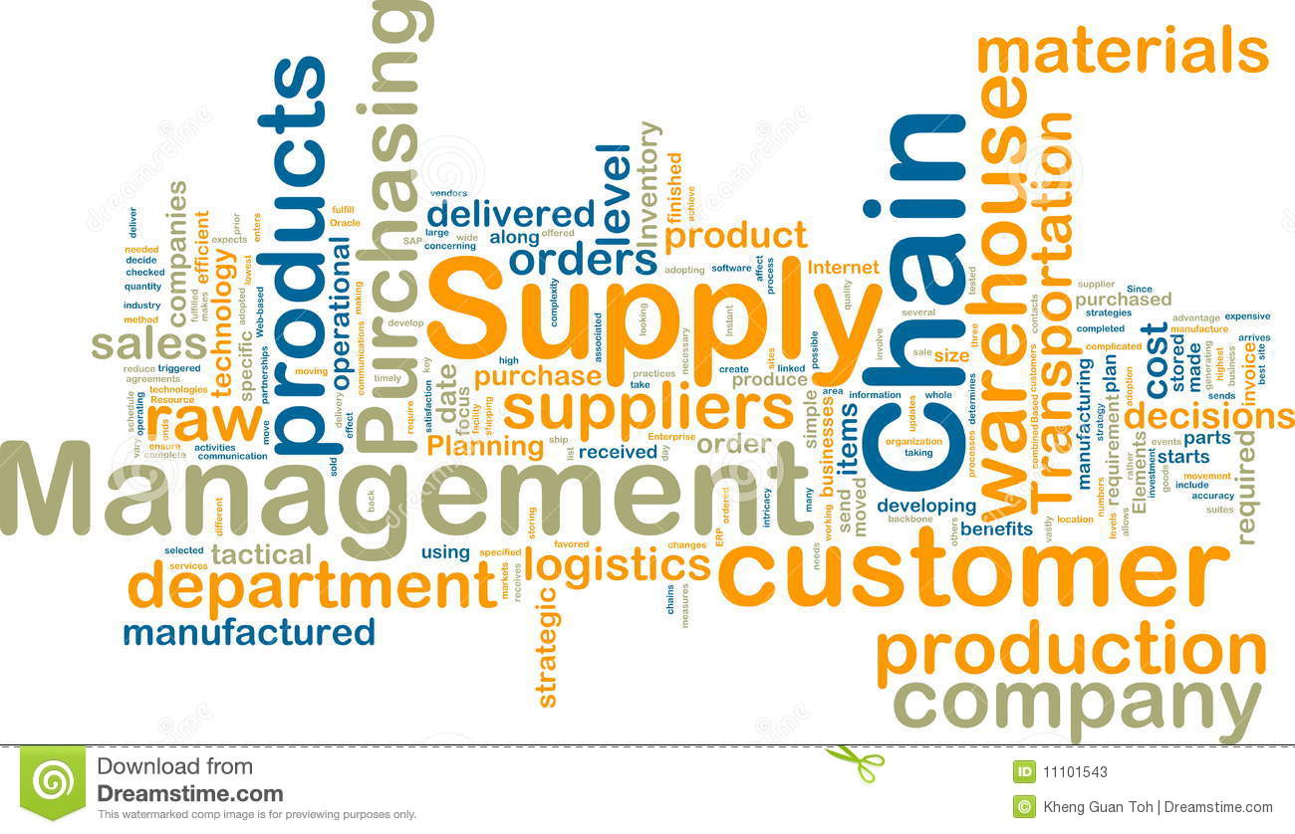
SUPPLY CHAIN MANAGEMENT
COMPANY:- A.AUTOPARTS

Slide 2
● A network of facilities includes:-
─Material flow from suppliers and their “upstream”
suppliers at all levels.
─Assembling of materials and testing of final products.
─Distribution of product to distributors and their
“downstream” customers at all levels.

Slide 3
UPSTREAM
INTERNAL
DOWNSTREAM
.
2nd TIER SUPPLIER
ASSEMLY AREA
1st TIER SUPPLIER
(AMAZON)
TESTING OF PRODUCT
DISTRIBUTOR
(JAY AUTO GARAGE)
2nd TIER SUPPLIER
R&D
TECHNICIAN
1st TIER SUPPLIER
(ALIBABA)
CUSTOMERS
2nd TIER SUPPLIER
ETHER COM
CORPORATION

Slide 4
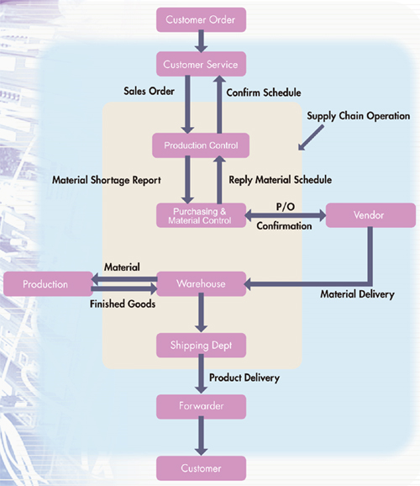

Slide 5


